Slide 1


Kris Kego
Department of Construction Management
Sem 1; 2016-2017

Slide 2

An essay is a short piece of writing that discusses, describes or analyzes one topic
It can discuss a subject directly or indirectly, seriously or humorously
It can describe personal opinions, or just report information
An essay can be written from any perspective, but essays are most commonly written in the first person (I), or third person (subjects that can be substituted with the he, she, it, or they pronouns).

Slide 3

Begin with a strong thesis
Support your thesis with specific evidence
Organize your essay connecting the evidence of introduction – conclusions – titles
Revising and editing sentences

Slide 4

Discuss:
  Make observations about the subject by using facts, arguments and reasoning.
Describe:
  Illustrate the topic using words.
Show:
  Set forth clear position or idea.
  Support it with facts and reason.
Explain:
  Make the essay plain and understandable
  Present logic, causes and reason.

Slide 5

General Subject: Marriage
  Limited Subject: Honeymoon
  Thesis: A honeymoon is perhaps the worst way to begin a marriage.
General Subject: Sports
  Limited Subject: Player's salaries
  Thesis: High player's salaries are bad for the game, for the fans, and for the values our children are developing

Slide 6

College poses new pressures for many students
  Heavy workload
  New people
  ?
The first day of high school was the worst of my life
  Couldn't find my first class
  Tripped and fell on the main staircase
  ?

Slide 7

Draft the Introduction.
Draft the Body
  Body Paragraph One.
  Body Paragraph Two.
  Body Paragraph Three.
  Body Paragraph X…
Draft the Conclusion

Slide 8

The writer states clearly what the essay is about and what they are trying to prove
Traditional essays urge the writer to restate the essay question
The writer has to maintain third person perspective and avoid meaningless statements such as "the essay will speak about" or "the essay is going to“
The essay topics will be presented in the body paragraphs of your college papers

Slide 9

Introductions
  General to narrow
  Starting with an opposite
  Stating importance of topic
  Incident or story
  Question(s)
  Quotation

Slide 10

The first body paragraph includes the topic sentence, supportive evidence and a closing sentence
The same format applies to all body paragraphs in the college essay
The essay may have as many body paragraphs as necessary to answer the essay question

Slide 11

The writer summarizes the subject of the traditional essay by restating the question in a different way
In conclusion, the writer expresses their personal opinion and conclusion about the essay question
Essay conclusion in a traditional essay is a summary of the body of the essay to prove the writer's point

Slide 12

Summary and final thought
Question(s)
Prediction
Recommendation

Slide 13

The expository essay
  The key here is that you are explaining an issue, theme or idea to your intended audience
The persuasive essay
  This is the type of essay where you try to convince the reader to adopt your position on an issue or point of view
The analytical essay
  In this type of essay you analyze, examine and interpret such things as an event, book, poem, play or other work of art

Slide 14
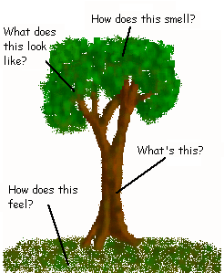
The descriptive essay provides details about how something looks, feels, tastes, smells, makes one feel, or sounds
It can also describe what something is, or how something happened
These essays generally use a lot of sensory details.

Slide 15
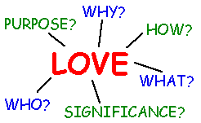
A definition essay attempts to define a specific term
It could try to pin down the meaning of a specific word, or define an abstract concept
The analysis goes deeper than a simple dictionary definition; it should attempt to explain why the term is defined as such
It could define the term directly, giving no information other than the explanation of the term

Slide 16
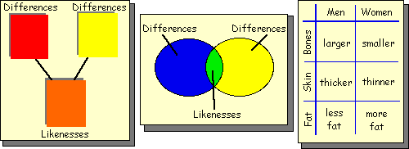
The compare/contrast essay discusses the similarities and differences between two things, people, concepts, places, etc.
It could also be written simply to entertain the reader, or to arrive at an insight into human nature
A comparison essay usually discusses the similarities between two things, while the contrast essay discusses the differences.

Slide 17
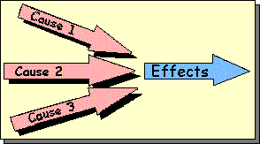
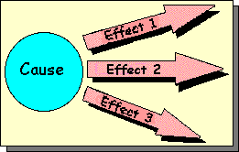
The cause/effect essay explains why or how some event happened, and what resulted from the event
This essay is a study of the relationship between two or more events or experiences
The essay could discuss both causes and effects, or it could simply address one or the other
A cause essay usually discusses the reasons why something happened
An effect essay discusses what happens after a specific event or circumstance.

Slide 18
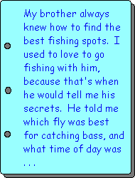
The narrative essay tells a story. It can also be called a "short story."
Generally the narrative essay is conversational in style, and tells of a personal experience
It is most commonly written in the first person (uses I)
This essay could tell of a single, life-shaping event, or simply a mundane daily experience.

Slide 19

A process essay describes how something is done
It generally explains actions that should be performed in a series
It can explain in detail how to accomplish a specific task, or it can show how an individual came to a certain personal awareness
The essay could be in the form of step-by-step instructions, or in story form, with the instructions/explanations subtly given along the way.

Slide 20
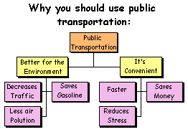
An argumentative essay is one that attempts to persuade the reader to the writer's point of view
The writer can either be serious or funny, but always tries to convince the reader of the validity of his or her opinion
The essay may argue openly, or it may attempt to subtly persuade the reader by using irony or sarcasm

Slide 21
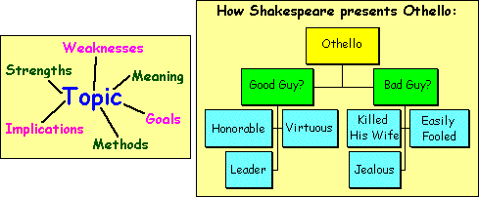
A critical essay analyzes the strengths, weaknesses and methods of someone else's work
Generally these essays begin with a brief overview of the main points of the text, movie, or piece of art, followed by an analysis of the work's meaning
It should then discuss how well the author/creator accomplishes his/her goals and makes his/her points
A critical essay can be written about another essay, story, book, poem, movie, or work of art

Slide 22

Unity Base
  Where are the sentences that are off topic, and don't support the topic sentence?
  Identify the sentence or sentences that should be eliminated from the paragraph in order to make it more unified
“When I was six years old, my mother took me to an adventure movie. I enjoyed the film immensely, but when I got home I could not sleep. I still suffer from insomnia sometimes but for different reasons now. In one scene in the film, the characters entered a cave filled with snakes. Those snakes haunted my dreams for months. I can still remember how vivid they seemed to me in my sleep.”

Slide 23
Support Base
  How do you create support in an essay?
  Revise the paragraph by providing specific supporting examples for the writer's main idea
“ Good friends are harder to find than most of us think. We all have people in our lives we call "friends," but that word describes so many different things. A co-worker or someone you see regularly at your hostel might be a friend. But whom do you turn to in a crisis? Who can you call at all hours of the night? Who can you depend on through thick and thin? “

Slide 24
Coherence Base
  How do you create coherence in an essay?
  Revise the paragraph by strengthening the organization of the supporting ideas and using transition words where appropriate
“The key to being an effective researcher is perseverance. If you cannot find information about a subject the first time you try, that doesn't mean you should give up. If you want to find out about "headhunters" you should also try the term "executive recruiters." Perhaps there is a better way to conduct your search. Perhaps you are using the wrong keyword.”

Slide 25
Sentence Skill Base
  As you read each sentence, you have to look at the sentence on 4 different levels:
    Is the sentence unified with the main idea? (keep the main idea in mind)
    Is the sentence a transition, or a general topic statement, or specific evidence? (keep the evidence in mind)
    Is the sentence coherent with other sentences nearby? (keep the organization or structure in mind)
    Is the sentence free of grammar, spelling, punctuation and other errors?

Slide 26

Lyon, E.S. 1992: Humanities graduates in the labour market.
In H. Eggins (ed.), Arts Graduates, their Skills and their Employment.
Knapper, C.K. and Cropley, A. 1991: Lifelong Learning and Higher Education. London: Croom Helm.
Berry, R. 2004: The Research Project: How to Write It
Gibaldi, J. 2004: MLA Handbook for Writers of Research Papers (sixth edition). New York: The Modern Language Association of America.

